Slide 1
RGU Hackathon 2018
Neil Paterson, Doug Cameron, David Hunt

Slide 2

Who are Brightree?
Microsoft .Net Software House
USA Healthcare Industry
Based in Atlanta, Georgia
Aberdeen office since early 2012
Glasgow office since early 2015
35 total employees over both UK locations
600 total employees between USA & UK
$800m ResMed acquisition in 2016

Slide 3


What we do?
Provides Software As A Service
Websites, Mobile Apps, APIs
32m page requests per day in 2017
36m page requests per day in 2018
3kg of M&Ms consumed per day
Other amazing things

Slide 4
Recruitment
Currently recruiting
Putting together graduate programme
Possibility of year long placements starting August 2018
Talk to Neil, Doug or David!

Slide 5

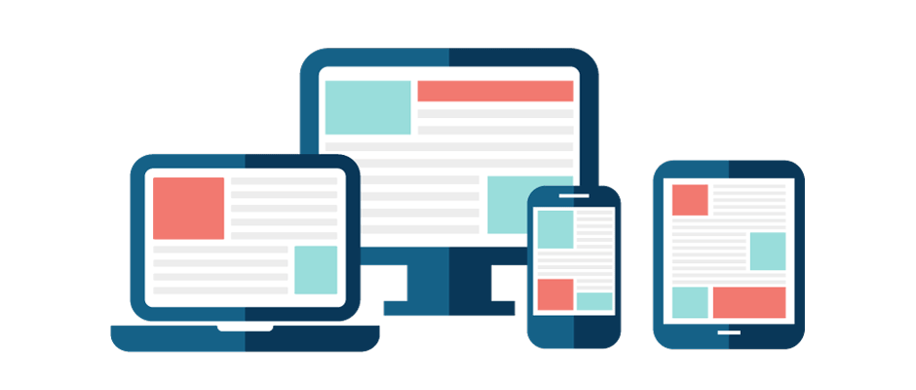

Challenge!
4 Amazon Echo Dots with us today
Facilitate 2 way communication between Alexa and a web/mobile app
Leverage the Cloud
Alexa Skill
Web or Mobile app

Slide 6
Challenge Example – The Shopping List
Use Alexa to manage your shopping list
Ask Alexa to add/remove items from the list
Ask Alexa to tell you what is on the list
Mobile/Web App can add/remove items
Mobile/Web App shows list
Everything should be 2 way bound, updating through Alexa is reflected on the App(s) and vice versa

Slide 7
Challenge Example – Bonus Points
Security
Multiple accounts/validation eg
Neil - “Alexa, we have run out of cling film! [thus world ending]”
Alexa - “Your wife already added cling film to the list”
Native Mobile app functionality
Notifications
Speech integration?!

Slide 8
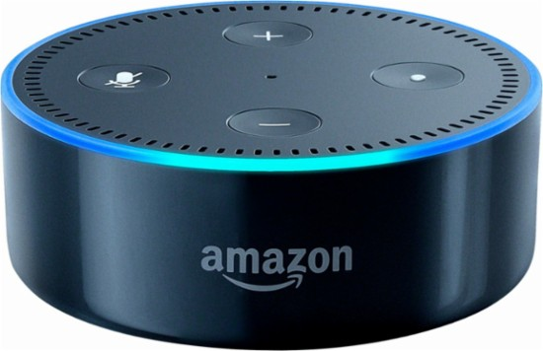
Challenge Prize
The Echo Dots…

